Slide 1
Lecture 2: Cryptology, Classical ciphers
Introduction to Computer Security

Slide 2
Acknowledgements and Reading
These slides are adapted from lecture slides by…
Lawrie Brown
Dan Boneh
and others
Reading: Chapter 2

Slide 3
Cryptography Use Cases

Slide 4
Cryptography is everywhere
Secure communication:
web traffic: HTTPS
wireless traffic: 802.11i WPA2 (and WEP), GSM, Bluetooth
Encrypting files on disk: EFS, TrueCrypt
Content protection (e.g. DVD, Blu-ray): CSS, AACS
User authentication
… and much much more

Slide 5
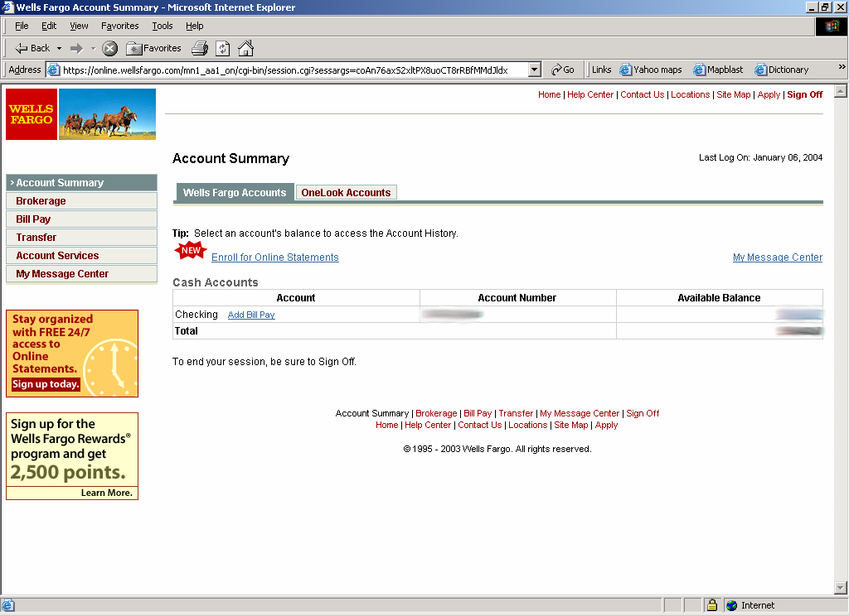
Secure communication
no eavesdropping
no tampering

Slide 6
Secure Sockets Layer / TLS
Two main parts
1. Handshake Protocol: Establish shared secret key using public-key cryptography (later lecture of course)
2. Record Layer: Transmit data using shared secret key
Ensure confidentiality and integrity (soon…)

Slide 7
Protected files on disk
Disk
File 1
Alice
Alice
No eavesdropping
No tampering
File 2
Analogous to secure communication:
Alice today sends a message to Alice tomorrow

Slide 8
Building block: sym. encryption
E, D: cipher k: secret key (e.g. 128 bits)
m, c: plaintext, ciphertext
Encryption algorithm is publicly known
Never use a proprietary cipher
Alice
Bob
m
E
E(k,m)=c
c
D
D(k,c)=m
k
k

Slide 9

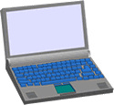

More Cases
Digital signatures
Anonymous communication
Alice signature
Who did I just talk to?
Alice
Bob

Slide 10

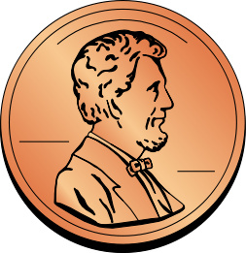
More Cases
Digital signatures
Anonymous communication
Anonymous digital cash
Can I spend a “digital coin” without anyone knowing who I am?
How to prevent double spending?
1$
Who was that?
Alice
Internet
(anon. comm.)

Slide 11

Protocols
Elections
Private auctions

Slide 12
Protocols
Elections
Private auctions
Secure multi-party computation
trusted authority
Goal: compute f(x₁, x₂, x₃, x₄)
“Thm:” anything that can done with trusted auth. can also be done without

Slide 13

Crypto magic
Privately outsourcing computation
Zero knowledge (proof of knowledge)
What did she search for?
search query
E[ query ]
Alice
E[ results ]
results
???
N=p∙q
Alice
I know the factors of N !!
proof π
N
Bob
Notes:
ZKPK: can be used for authentication

Slide 14
A rigorous science
The three steps in cryptography:
Precisely specify threat model
Propose a construction
Prove that breaking construction under threat mode will solve an underlying hard problem
Notes:
Example: define what it means to forge signatures, give construction, show that forging signatures is as hard as factoring.

Slide 15
Things to remember
Cryptography is:
A tremendous tool
The basis for many security mechanisms
Cryptography is not:
The solution to all security problems
Reliable unless implemented and used properly
Something you should try to invent yourself
many many examples of broken ad-hoc designs

Slide 16
Basic Concepts

Slide 17
Symmetric Encryption
or private-key / single-key
sender and recipient share a common key
all classical encryption algorithms are private-key
and by far most widely used
Notes:
Symmetric encryption, also referred to as conventional encryption or single-key encryption, was the only type of encryption in use prior to the development of public-key encryption in the 1970s. It remains by far the most widely used of the two types of encryption. All traditional schemes are symmetric / single key / private-key encryption algorithms, with a single key, used for both encryption and decryption. Since both sender and receiver are equivalent, either can encrypt or decrypt messages using that common key.

Slide 18
Some Basic Terminology
plaintext - original message
ciphertext - coded message
key - info used in cipher known only to sender/receiver
encipher (encrypt) - converting plaintext to ciphertext
decipher (decrypt) - recovering ciphertext from plaintext
cryptography - study of encryption principles/methods
cryptanalysis (codebreaking) - study of principles/ methods of deciphering ciphertext without knowing key
cryptology - field of both cryptography and cryptanalysis
Notes:
Briefly review some terminology used throughout the course.

Slide 19
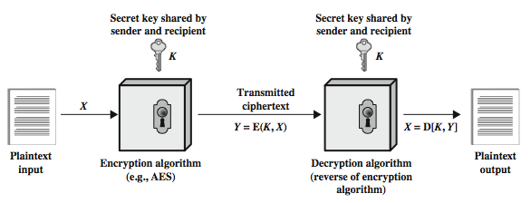
Symmetric Cipher Model
Notes:
Detail the five ingredients of the symmetric cipher model, shown in Stallings Figure 2.1:
plaintext - original message
encryption algorithm – performs substitutions/transformations on plaintext
secret key – control exact substitutions/transformations used in encryption algorithm
ciphertext - scrambled message
decryption algorithm – inverse of encryption algorithm

Slide 20
Requirements
mathematically have:
Y = E(K, X)
X = D(K, Y)
two requirements for secure use of symmetric encryption:
a strong encryption algorithm
a secret key K known only to sender / receiver
assume encryption algorithm is known，implies a secure channel to distribute key
Notes:
There are two requirements for secure use of conventional encryption that mean we assume that it is impractical to decrypt a message on the basis of the cipher- text plus knowledge of the encryption/decryption algorithm, and hence do not need to keep the algorithm secret; rather we only need to keep the key secret. This feature of symmetric encryption is what makes it feasible for widespread use. It allows easy distribution of s/w and h/w implementations.
Can take a closer look at the essential elements of a symmetric encryption scheme: mathematically it can be considered a pair of functions with: plaintext X, ciphertext Y, key K, encryption algorithm E, decryption algorithm D. The intended receiver, in possession of the key, is able to invert the transformation. An opponent, observing Y but not having access to K or X, may attempt to recover X or K.

Slide 21
Cryptography
can characterize cryptographic system by:
type of encryption operations used
substitution
transposition
product
number of keys used
single-key or private
two-key or public
way in which plaintext is processed
block
stream
Notes:
Cryptographic systems can be characterized along these three independent dimensions.
The type of operations used for transforming plaintext to ciphertext. All encryption algorithms are based on two general principles: substitution, in which each element in the plaintext (bit, letter, group of bits or letters) is mapped into another element, and transposition, in which elements in the plaintext are rearranged. The fundamental requirement is that no information be lost (that is, that all operations are reversible). Most systems, referred to as product systems, involve multiple stages of substitutions and transpositions.
The number of keys used. If both sender and receiver use the same key, the system is referred to as symmetric, single-key, secret-key, or conventional encryption. If the sender and receiver use different keys, the system is referred to as asymmetric, two-key, or public-key encryption.
The way in which the plaintext is processed. A block cipher processes the input one block of elements at a time, producing an output block for each input block. A stream cipher processes the input elements continuously, producing output one element at a time, as it goes along.

Slide 22
Cryptanalytic Attacks
ciphertext only
only know algorithm & ciphertext, is statistical, know or can identify plaintext
known plaintext
know/suspect plaintext & ciphertext
chosen plaintext
select plaintext and obtain ciphertext
chosen ciphertext
select ciphertext and obtain plaintext
Notes:
Stallings Table 2.1 summarizes the various types of cryptanalytic attacks, based on the amount of information known to the cryptanalyst, from least to most. The most difficult problem is presented when all that is available is the ciphertext only. In some cases, not even the encryption algorithm is known, but in general we can assume that the opponent does know the algorithm used for encryption. Then with increasing information have the other attacks. Generally, an encryption algorithm is designed to withstand a known-plaintext attack.

Slide 23
Classical Ciphers

Slide 24
Caesar Cipher
a kind of substitution cipher
earliest known substitution cipher，first attested use in military affairs
replaces each letter by 3rd letter on
example:
meet me after the toga party
PHHW PH DIWHU WKH WRJD SDUWB
Notes:
Substitution ciphers form the first of the fundamental building blocks. The core idea is to replace one basic unit (letter/byte) with another. Whilst the early Greeks described several substitution ciphers, the first attested use in military affairs of one was by Julius Caesar, described by him in Gallic Wars (cf. Kahn pp83-84). Still call any cipher using a simple letter shift a caesar cipher, not just those with shift 3.

Slide 25
Caesar Cipher
can define transformation as:
a b c d e f g h i j k l m n o p q r s t u v w x y z
D E F G H I J K L M N O P Q R S T U V W X Y Z A B C
mathematically give each letter a number
a b c d e f g h i j k l m n o p q r s t u v w x y z
0 1 2 3 4 5 6 7 8 9 10 11 12 13 14 15 16 17 18 19 20 21 22 23 24 25
then have Caesar cipher as:
c = E(k, p) = (p + k) mod (26)
p = D(k, c) = (c – k) mod (26)
Notes:
This mathematical description uses modulo (clock) arithmetic. Here, when you reach Z you go back to A and start again. Mod 26 implies that when you reach 26, you use 0 instead (ie the letter after Z, or 25 + 1 goes to A or 0).
Example: howdy (7,14,22,3,24) encrypted using key f (ie a shift of 5) is MTBID

Slide 26
Cryptanalysis of Caesar Cipher
only have 26 possible ciphers
A maps to A,B,..Z
could simply try each in turn，a brute force search
do need to recognize when have plaintext
eg. break ciphertext "GCUA VQ DTGCM"
Notes:
With a caesar cipher, there are only 26 possible keys, of which only 25 are of any use, since mapping A to A etc doesn't really obscure the message! Note this basic rule of cryptanalysis "check to ensure the cipher operator hasn't goofed and sent a plaintext message by mistake"!
Can try each of the keys (shifts) in turn, until can recognise the original message. See Stallings Fig 2.3 for example of search.
Note: as mentioned before, do need to be able to recognise when have an original message (ie is it English or whatever). Usually easy for humans, hard for computers. Though if using say compressed data could be much harder.
Example "GCUA VQ DTGCM" when broken gives "easy to break", with a shift of 2 (key C).

Slide 27
Monoalphabetic Cipher
rather than just shifting the alphabet，could shuffle (jumble) the letters arbitrarily
each plaintext letter maps to a different random ciphertext letter
hence key is 26 letters long
Plain: abcdefghijklmnopqrstuvwxyz
Cipher: DKVQFIBJWPESCXHTMYAUOLRGZN
Plaintext: ifwewishtoreplaceletters
Ciphertext: WIRFRWAJUHYFTSDVFSFUUFYA
Notes:
With only 25 possible keys, the Caesar cipher is far from secure. A dramatic increase in the key space can be achieved by allowing an arbitrary substitution, where the translation alphabet can be any permutation of the 26 alphabetic characters. A permutation of a finite set of elements S is an ordered sequence of all the elements of S, with each element appearing exactly once. In general, there are n! permutations of a set of n elements.
See text example of a translation alphabet, and an encrypted message using it.

Slide 28
Monoalphabetic Cipher Security
now have a total of 26! = 4 x 10²⁶ keys
with so many keys, might think is secure
but would be !!!WRONG!!!
problem is language characteristics
Notes:
Note that even given the very large number of keys, being 10 orders of magnitude greater than the key space for DES, the monoalphabetic substitution cipher is not secure, because it does not sufficiently obscure the underlying language characteristics.

Slide 29
Language Redundancy and Cryptanalysis
human languages are redundant
letters are not equally commonly used
in English E is by far the most common letter
followed by T,R,N,I,O,A,S
other letters like Z,J,K,Q,X are fairly rare
have tables of single, double & triple letter frequencies for various languages
Notes:
As the example shows, we don't actually need all the letters in order to understand written English text. Here vowels were removed, but they're not the only redundancy. cf written Hebrew has no vowels for same reason. Are usually familiar with "party conversations", can hear one person speaking out of hubbub of many, again because of redundancy in aural language also. This redundancy is also the reason we can compress text files, the computer can derive a more compact encoding without losing any information. Basic idea is to count the relative frequencies of letters, and note the resulting pattern.

Slide 30
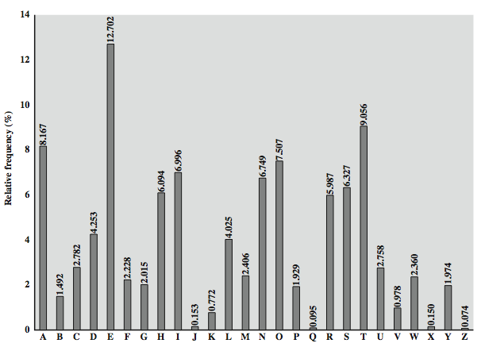
English Letter Frequencies
Notes:
Note that all human languages have varying letter frequencies, though the number of letters and their frequencies varies. Stallings Figure 2.5 shows English letter frequencies. Seberry & Pieprzyk, "Cryptography - An Introduction to Computer Security", Prentice-Hall 1989, Appendix A has letter frequency graphs for 20 languages (most European & Japanese & Malay). Also useful are tables of common two-letter combinations, known as digrams, and three-letter combinations, known as trigrams.

Slide 31
Use in Cryptanalysis
key concept - monoalphabetic substitution ciphers do not change relative letter frequencies
discovered by Arabian scientists in 9th century
calculate letter frequencies for ciphertext，compare counts/plots against known values
for monoalphabetic must identify each letter
tables of common double/triple letters help
Notes:
The simplicity and strength of the monoalphabetic substitution cipher meant it dominated cryptographic use for the first millenium AD. It was broken by Arabic scientists. The earliest known description is in Abu al-Kindi's "A Manuscript on Deciphering Cryptographic Messages", published in the 9th century but only rediscovered in 1987 in Istanbul, but other later works also attest to their knowledge of the field. Monoalphabetic ciphers are easy to break because they reflect the frequency data of the original alphabet. The cryptanalyst looks for a mapping between the observed pattern in the ciphertext, and the known source language letter frequencies. If English, look for peaks at: A-E-I triple, NO pair, RST triple, and troughs at: JK, X-Z.
Monoalphabetic ciphers are easy to break because they reflect the frequency data of the original alphabet.

Slide 32
Example Cryptanalysis
given ciphertext:
UZQSOVUOHXMOPVGPOZPEVSGZWSZOPFPESXUDBMETSXAIZ
VUEPHZHMDZSHZOWSFPAPPDTSVPQUZWYMXUZUHSX
EPYEPOPDZSZUFPOMBZWPFUPZHMDJUDTMOHMQ
count relative letter frequencies (see text)
guess P & Z are e and t
guess ZW is th and hence ZWP is the
proceeding with trial and error finally get:
it was disclosed yesterday that several informal but
direct contacts have been made with political
representatives of the viet cong in moscow
Notes:
Illustrate the process with this example from the text in Stallings section 2.2. Comparing letter frequency breakdown with Figure 2.5, it seems likely that cipher letters P and Z are the equivalents of plain letters e and t, but it is not certain which is which. The letters S, U, O, M, and H are all of relatively high frequency and probably correspond to plain letters from the set {a, h, i, n, o, r, s}. The letters with the lowest frequencies (namely, A, B, G, Y, I, J) are likely included in the set {b, j, k, q, v, x, z}. A powerful tool is to look at the frequency of two-letter combinations, known as digrams. A table similar to Figure 2.5 could be drawn up showing the relative frequency of digrams. The most common such digram is th. In our ciphertext, the most common digram is ZW, which appears three times. So we make the correspondence of Z with t and W with h. Then, by our earlier hypothesis, we can equate P with e. Now notice that the sequence ZWP appears in the ciphertext, and we can translate that sequence as "the." This is the most frequent trigram (three- letter combination) in English, which seems to indicate that we are on the right track. Next, notice the sequence ZWSZ in the first line. We do not know that these four letters form a complete word, but if they do, it is of the form th_t. If so, S equates with a. Only four letters have been identified, but already we have quite a bit of the message. Continued analysis of frequencies plus trial and error should easily yield a solution from this point. The complete plaintext, with spaces added between words, is shown on slide.

Slide 33
Vigener cipher (16’th century, Rome)
k = C R Y P T O
C R Y P T O
C R Y P T
(+ mod 26)
m = W H A T A N I C E D A Y T O D A Y
c = Z Z Z J U C L U D T U N W G C Q S
Notes:
Explain how to break

Slide 34
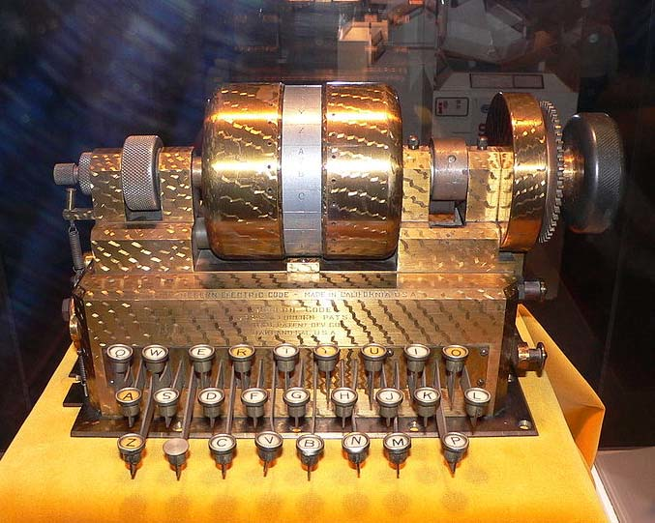
Rotor Machines (1870-1943)
Early example: the Hebern machine (single rotor)
A
B
C
.
.
X
Y
Z
K
S
T
.
.
R
N
E
E
K
S
T
.
.
R
N
N
E
K
S
T
.
.
R
key

Slide 35
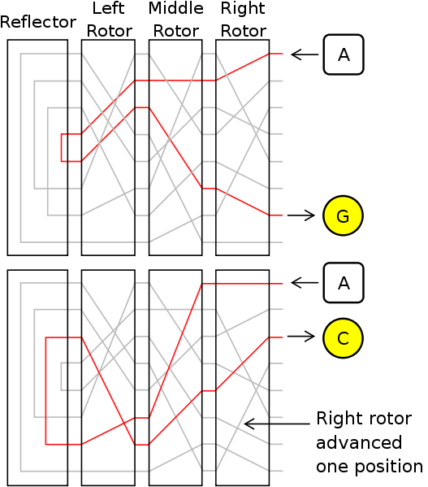
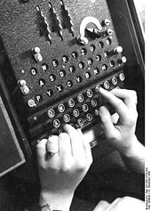
Rotor Machines (cont.)
Most famous: the Enigma (3-5 rotors)
# keys = 26⁴ = 2¹⁸ (actually 2³⁶ due to plugboard)

Slide 36
Data Encryption Standard (1974)
DES: # keys = 2⁵⁶ , block size = 64 bits
Today: AES (2001), Salsa20 (2008) (and many others)

Slide 37
Summary
have considered:
cryptography use cases，cryptography overview
classical cipher techniques and terminology
substitution ciphers
cryptanalysis using letter frequencies
product ciphers and rotor machines
Notes:
Chapter 2 summary.

